Slide 1
Bitcoin Analysis
Alek Birkeland Peter DiBona John Melvin Franklin Vaca

Slide 2
Background and Motivation
Our group had two main goals for this project.
Our first goal was to find out which combination of moving averages produced the best trading signals and portfolio performance.
The second goal was to figure out which type of model would best predict the price of Bitcoin.
Going into this we made no assumptions about which type of models to use, however we researched some of the most used models in crypto trading and tested them.
Models that we tested include LSTM, SVR, SVR-Tuned, Ridge and Lasso.

Slide 3
Data Cleanup & Model Training
Data Cleanup & Model Training
Our dataset consisted of standard Bitcoin price information downloaded in a CSV file.
We first dropped na values
We had to reverse order our dataset to get our plots to show correctly.
We had difficulty getting validation data to run properly on the LSTM model.
We ran into some challenges when determining which scaler to use between StandardScaler, MinMaxScaler and RobustScaler.
We NumPy .shape/.reshape and Pandas .transform.

Slide 4
Moving Averages analysis
We reviewed the entire Bitcoin dataset to find optimum moving average combinations.
We settled on using the Short Moving Average of 20 days and the Long Moving Average of 80 days.
Trading signals produced when Moving Averages cross these thresholds would generate a portfolio of ~$10K with an initial investment of $3K.

Slide 5
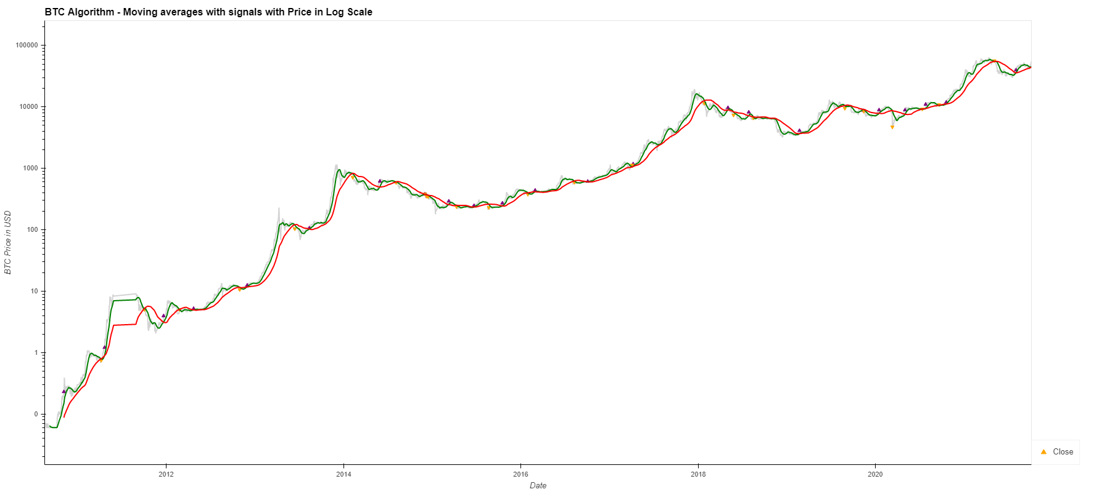
Moving Average Plot
Signals shown with short 20 and long 80

Slide 6
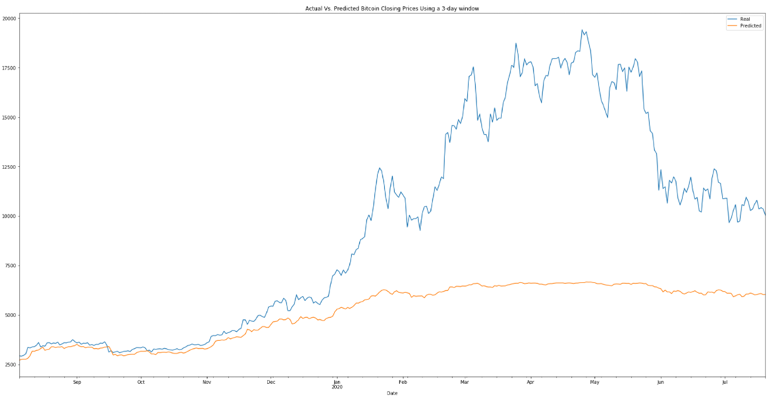
Model Summaries: Comparing options
LSTM – Long short term memory neural network.

Slide 7
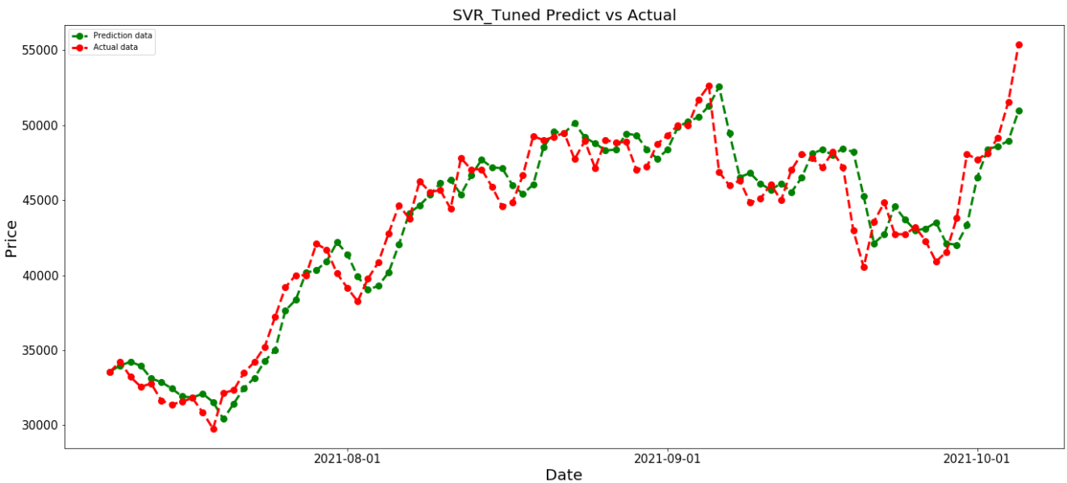
Model Summaries: Comparing options
SVR(Support Vector Regression) and SVR Tuned/SVM.
Support Vector Regression is a supervised learning algorithm that is used to predict discrete values. ... Unlike other Regression models that try to minimize the error between the real and predicted value, the SVR tries to fit the best line within a threshold value.

Slide 8

Model Summaries: Comparing options
Ridge Regression is an extension of linear regression that adds a regularization penalty to the loss function during training.

Slide 9
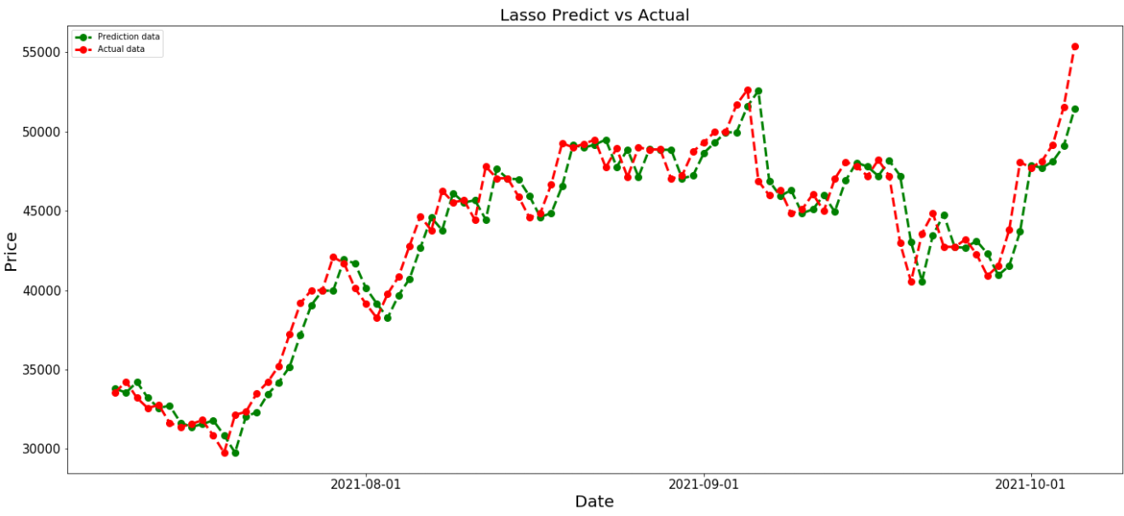
Model Summaries: Comparing options
Lasso Regression that uses “shrinkage” to shrink values towards a central point or the mean.

Slide 10
Model Evaluation
We created a separate function to evaluate our models against
each other.
We used Root Mean Square Error (RMSE) and R-squared (R2) scores to evaluate performance.
We were looking for the model with the lowest RMSE score as well as the R2 score closest to 1.

Slide 11
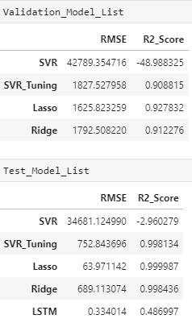
Model Performance Discussion
We created a new dataframe to house our model results.
While actual score results vary slightly each time they are run, we consistently observed the Lasso model as the best performer in RMSE and R2.

Slide 12
If We Only Had More Time:
We would like to evaluate more minute distances (smaller numbers) from standard moving averages.
Add in Volume data to models.
Analyze exponential moving averages. EMA
Check more performance metrics and use other libraries.
Look at more assets (ETH, Stock prices, etc.)
Expand use of Yahoo Finance python library.
We had some difficulties getting the LSTM model to have the same output as the other types of models.
Play with different numbers of Epochs and batch sizes.
Would have preferred to compare models using same libraries.

Slide 13
Questions?

